Slide 1
Design and Analysis of Algorithms
Recurrence Relation
National University of Computer and Emerging Sciences, Islamabad

Slide 2

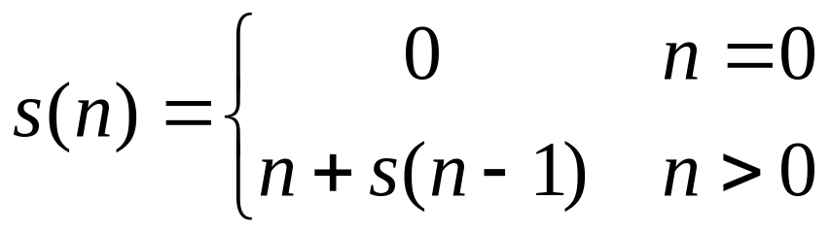
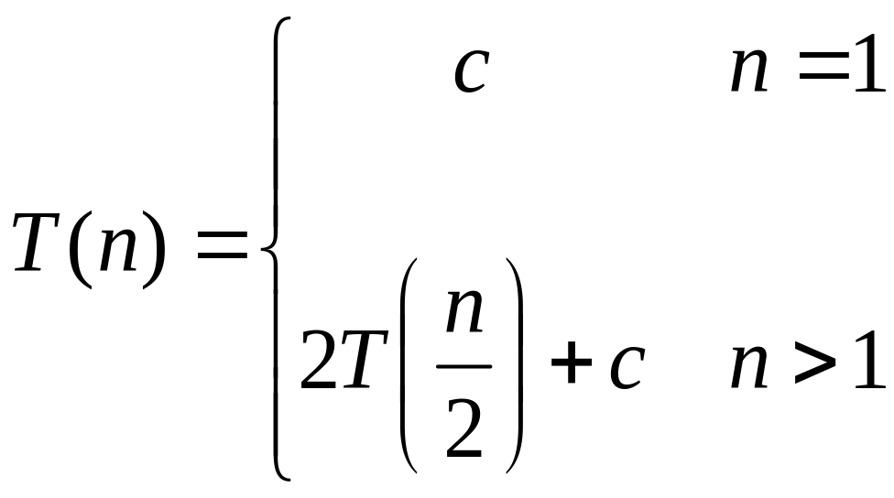

Recurrence Examples

Slide 3
Methods to solve recurrence
Iteration method
Substitution method
Recursion tree method
Master Theorem

Slide 4
Solving Recurrences
“iteration method”
  Work some algebra to express as a summation
  Evaluate the summation

Slide 5

Example 1
s(4)
s(n-1) = c + s(n-2)
c
s(3)
s(n-2) = c + s(n-3)
c
s(2)
c
s(1)
c
s(0)
=4c+s(0)
=4c+0
=4c
=nc = n
n=4

Slide 6
Example 1
s(4) =
c + s(4-1)
c + c + s(4-2)
2c + s(4-2)
2c + c + s(4-3)
3c + s(4-3)
4c + s(4-4)
= 4c + s(0)
=4c+0 [Stops here]
=nc
s(n-1) = c + s(n-2)
s(n-2) = c + s(n-3)

Slide 7
Example 1
s(n) =
c + s(n-1)
s(n-1) = c + s(n-2)

Slide 8
Example 1
s(n) =
c + s(n-1)
c + c + s(n-2)
s(n-1) = c + s(n-2)

Slide 9
Example 1
s(n) =
c + s(n-1)
c + c + s(n-2)
2c + s(n-2)
s(n-1) = c + s(n-2)
s(n-2) = c + s(n-3)

Slide 10
Example 1
s(n) =
c + s(n-1)
c + c + s(n-2)
2c + s(n-2)
2c + c + s(n-3)
s(n-1) = c + s(n-2)
s(n-2) = c + s(n-3)

Slide 11
Example 1
s(n) =
c + s(n-1)
c + c + s(n-2)
2c + s(n-2)
2c + c + s(n-3)
3c + s(n-3)
s(n-1) = c + s(n-2)
s(n-2) = c + s(n-3)

Slide 12
Example 1
s(n) =
c + s(n-1)
c + c + s(n-2)
2c + s(n-2)
2c + c + s(n-3)
3c + s(n-3)
…
kc + s(n-k) = ck + s(n-k)
s(n-1) = c + s(n-2)
s(n-2) = c + s(n-3)

Slide 13
Example 1
s(n) =
c + s(n-1)
2c + s(n-2)
3c + s(n-3)
…
kc + s(n-k) = ck + s(n-k)
s(n-1) = c + s(n-2)
s(n-2) = c + s(n-3)

Slide 14
Example 1
s(n) =
c + s(n-1)
2c + s(n-2)
3c + s(n-3)
4c + s(n-4)
…
kc + s(n-k) = ck + s(n-k)
s(n-1) = c + s(n-2)
s(n-2) = c + s(n-3)

Slide 15
Example 1
So far for n >= k we have
  s(n) = ck + s(n-k)
What if k = n?
  s(n) = cn + s(0) = cn

Slide 16
Example 1
So far for n >= k we have
  s(n) = ck + s(n-k)
What if k = n?
  s(n) = cn + s(0) = cn
So
Thus in general
  s(n) = cn

Slide 17
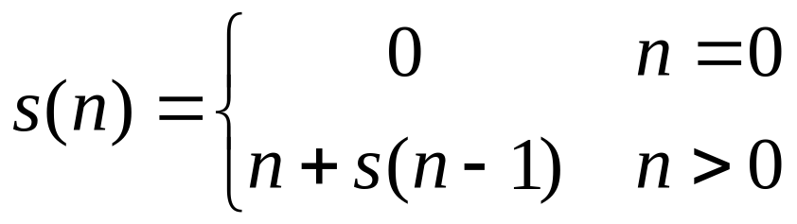
Example 2
s(n)

Slide 18
Example 2
s(n)
= n + s(n-1)

Slide 19
Example 2
s(n)
= n + s(n-1)
= n + n-1 + s(n-2)

Slide 20
Example 2
s(n)
= n + s(n-1)
= n + n-1 + s(n-2)
= n + n-1 + n-2 + s(n-3)

Slide 21
Example 2
s(n)
= n + s(n-1)
= n + n-1 + s(n-2)
= n + n-1 + n-2 + s(n-3)
= n + n-1 + n-2 + n-3 + s(n-4)

Slide 22
Example 2
s(n)
= n + s(n-1)
= n + n-1 + s(n-2)
= n + n-1 + n-2 + s(n-3)
= n + n-1 + n-2 + n-3 + s(n-4)
= …
= n + n-1 + n-2 + n-3 + … + n-(k-1) + s(n-k)

Slide 23
Example 2
s(5)
= 5 + s(5-1) =5+S(4)
= 5 + 4 + s(5-2) =5+4+S(3)
= 5 + 4 + 3 + s(5-3) = 5+4+3+S(2)
= 5 + 4 + 3 + 2 + s(5-4) =5+4+3+2+S(1)
= 5 + 4 + 3 + 2 +1+ s(5-5) =5+4+3+2+1+S(0)

Slide 24
Example 2
s(n)
= n + s(n-1)
= n + n-1 + s(n-2)
= n + n-1 + n-2 + s(n-3)
= n + n-1 + n-2 + n-3 + s(n-4)
= …
= n + n-1 + n-2 + n-3 + … + n-(k-1) + s(n-k)

Slide 25
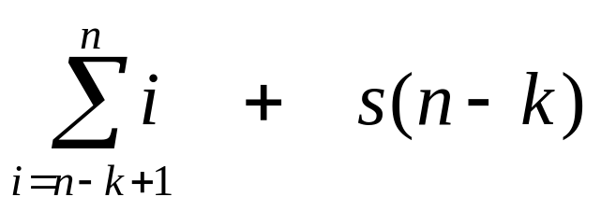
Example 2
s(n)
= n + s(n-1)
= n + n-1 + s(n-2)
= n + n-1 + n-2 + s(n-3)
= n + n-1 + n-2 + n-3 + s(n-4)
= …
= n + n-1 + n-2 + n-3 + … + n-(k-1) + s(n-k)
=

Slide 26
Example 2
So far for n >= k we have

Slide 27
Example 2
So far for n >= k we have
What if k = n?
S(5)=5 + 4 + 3 + 2 +1+ s(5-5)
=5+4+3+2+1+S(0)

Slide 28
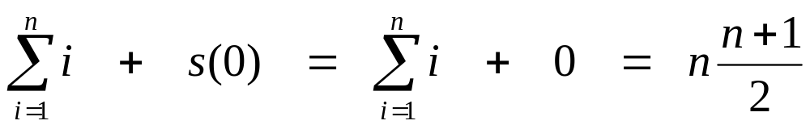
Example 2
So far for n >= k we have
What if k = n?

Slide 29
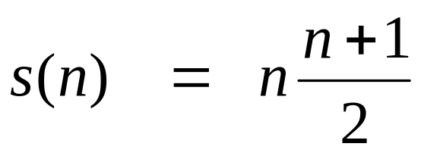
Example 2
So far for n >= k we have
What if k = n?
Thus in general

Slide 30
Home Activity
Example 3
Solve the following Recurrence using iteration Method
        T(1) = 1
        T(n) = 2 T(n/2) + n
Note: Before looking at the solution, do it by yourself

Slide 31
Home Activity
Example 3
T(n) = 2T(n/2) + n
= 2(2T(n/4) + n/2) + n
= 4T(n/4) + n + n
= 4(2T(n/8) + n/4) + n + n
= 8T(n/8) + n + n + n
= nT(n/n) + n + ... + n + n + n
= n + n + ... + n + n + n

Slide 32
Home Activity
Example 3
T(n) = 2T(n/2) + n
= 2(2T(n/4) + n/2) + n
= 4T(n/4) + n + n
= 4(2T(n/8) + n/4) + n + n
= 8T(n/8) + n + n + n
= nT(n/n) + n + ... + n + n + n
= n + n + ... + n + n + n
Counting the number of repetitions of n in the sum at the end, we see that there are lg n + 1 of them. Thus the running time is n(lg n + 1) = n lg n + n. We observe that n lg n + n < n lg n + n lg n = 2n lg n for n>0, so the running time is O(n lg n).
Reference: https://www.cs.cornell.edu/courses/cs3110/2014sp/recitations/21/solving-recurrences.html

Slide 33
Divide and Conquer
The divide-and-conquer paradigm
What is a paradigm? One that serves as a pattern or model.
Divide the problem into a number of subproblems
Conquer the subproblems by solving them recursively. If small enough, just solve directly without recursion
Combine the solutions of the subproblems into the solution for the original problem

Slide 34
Analyzing Divide-and-Conquer Algorithms
Let T(n) be the running time on a problem of size n.
If problem is small enough, then solution takes constant time (this is a boundary condition, which will be assumed for all analyses)
It takes time to divide the problem into sub-problems at the beginning. Denote this work by D(n).

Slide 35
Analyzing Divide-and-Conquer Algorithms
It takes time to combine the solutions at the end. Denote this by C(n).
If we divide the problem into ‘a’ problems, each of which is ‘1/b’ times the original size (n), and since the time to solve a problem with input size ‘n/b’ is T(n/b), and this is done ‘a’ times, the total time is:
T(n) = Θ(1), n small (or n ≤ c )
T(n) = aT(n/b) + D(n) + C(n)

Slide 36
Reference
Introduction to Algorithms
Chapter # 4
  Thomas H. Cormen
  3rd Edition

